Slide 1

Period End Closing Key Process Areas and New Period End Checks
Currency Revaluation
G/L Closing Activities for Financial Statement Preparation
AP/AR Regrouping
Currency Translation
Functional Area Adjustment

Slide 2
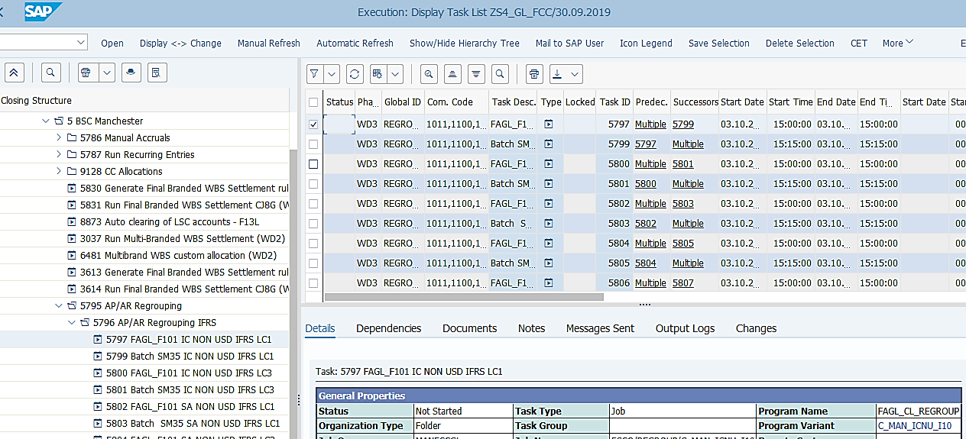
AP/AR Regrouping Process Overview
Basic Process of AP/AR Regrouping
Revaluation
AP/AR Regrouping
Translation
All monetary B/S accounts are revaluated in the Revaluation step.
These include the Vendor and Customer open items which will be assessed during the AP/AR Regrouping process.
AP/AR Regrouping logic in S/4 remains the same as in ECC. The system checks the balances on Vendor/Customer accounts per reconciliation account, then make reclassification postings based on the AP/AR Regrouping rules, i.e. reclassification from short term to long term, or reclassify the debit balances in AP to AR and vice versa, using AP/AR Regrouping accounts (ending with 7).
The process will be executed for all entities in IFRS ledger. For STAT and/or TAX it will be executed only for entities which request it.
In S/4 Translation is scheduled after AP/AR Regrouping as Regrouping does not capture the LC2/LC3 amounts correctly.
During Translation for B/S accounts, all B/S accounts are included in calculation. This means the balances for AP/AR Regrouping accounts are translated too.
AP/AR Regrouping uses the results from Revaluation, therefore the variants are specific to different groups of company codes, which do not use the Company Code variable. The variants use variables for dates/periods/years. You should always check the dates/periods/years are correctly populated before executing Regrouping outside of FCC.
T-Code: FAGLF101
This is a new transaction code but very similar to the one used in ECC for the same purpose.
Variants are created for the similar categories as in ECC, e.g. USD/Non-USD entities, for 3rd party or IC AP/AR, regrouping of LC1 or LC3, plus for each core ledger IFRS, STAT and TAX (if STAT/TAX regrouping is requested by entities.) Some variants are for a group of entities within one country, some are for specific types of entities, although all such tasks are set at GBS/JTBC level.
FCC Task: GBS/JTBC Level
The AP/AR Regrouping task is set at GBS/JTBC level. If you need to execute AP/AR Regrouping outside of FCC due to any delay of closing of specific entities, you may need to check the variant and make necessary changes before executing it manually.
Timing: WD3 – IFRS
WD10 – STAT/TAX
AP/AR Regrouping is performed on WD3 for IFRS and WD10 for STAT/TAX, before the execution of Currency Translation steps for the respective ledgers.

Slide 3
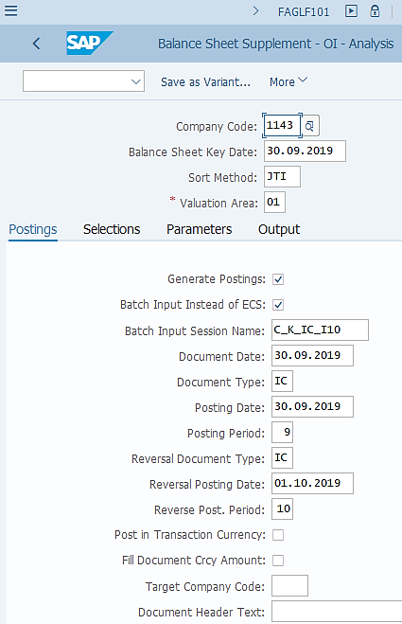
AP/AR Regrouping: Execution (1/2)
FAGLF101: AP/AR Regrouping – Postings tab
Make sure you use the same variant as specified in the corresponding FCC task if you need to execute this transaction outside of FCC. It is possible you may need to modify the variant if need (e.g. if something is wrong, or one entity is delaying the global closing, etc.)
The entities included in each variant are determined based on the similarity of the their business requirements, therefore do not mix entities which are set in different variants into one when executing this transaction outside of FCC. When you have a new entity, or an existing entity which changes its business requirement, you should carefully add/remove the corresponding company code to/from a variant.
AP/AR Regrouping is to be done with the key date of the last day of the month being closed.
The Sort Method JTI controls which AP/AR open item is to be selected for regrouping, in which category of regrouping and how the regrouping postings should be made.
This is exactly the same Valuation Area used in Revaluation and Translation (after AP/AR Regrouping). As explained earlier, we use Valuation areas 01-03 for IFRS, S* for Statutory and T* for Tax ledgers respectively. Therefore depending on the AP/AR Regrouping variant, the corresponding Valuation Area is specified here.
Select Generate Postings for an update run with Batch Input session generated. De-select it works as a test run with no posting generated.
These settings ensure that a Batch Input session is generated for processing, which will retain the document numbers information once the session is successfully processed. The Batch Input session name corresponds to the AP/AR Regrouping variant name, which helps users to identify them easily.
The AP/AR Regrouping shall be posted with Document Date and Posting Date of the last date of the month being closed, and reversed on the first date of the following month.
Note that depending on the purpose of a variant, e.g. in this example it is for IC vendors/customers, then the Document Type should be IC. If this is for 3rd party vendors/customer, then the Document Type should be SA.

Slide 4
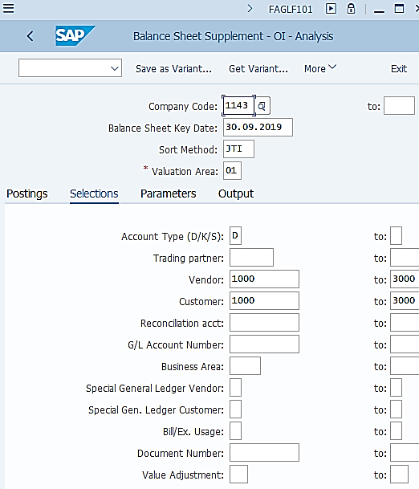
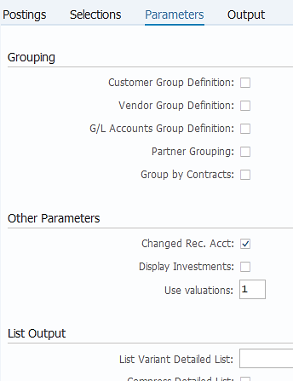
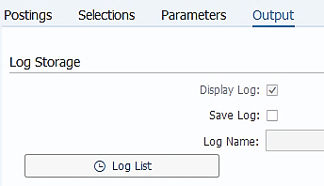
AP/AR Regrouping: Execution (2/2)
FAGLF101: AP/AR Regrouping – Selections tab
As explained, the AP/AR Regrouping variants are created for different categories of company codes, vendors/customers, currencies and ledgers. One of the categories is whether the vendors/customers that we are regrouping are 3rd Party vendors/customers or Intercompany ones. This is the place where you specify them.
For IC AP/AR Regrouping variants, we will put vendor and customer range of 1000-3000. For 3rd Party vendors/customers we will put the range of not equal to 1000-3000. Account Type selection is always D and K, which represents customers and vendors accounts only.
This checkbox is ticked as we would like to repost the balances in a vendor/customer which are linked to their old reconciliation account to the new one, in case the reconciliation account for the vendor/customer has changed during the month.
Parameters tab
This shows “1” by default and this default should be kept in your variant. This means when we run AP/AR Regrouping, the system will take into consideration of the revaluation results for the vendors/customers that going to be regrouped.
This is ticked by system default. It will allow the log to be displayed once you have executed this transaction on the screen.
Output tab

Slide 5
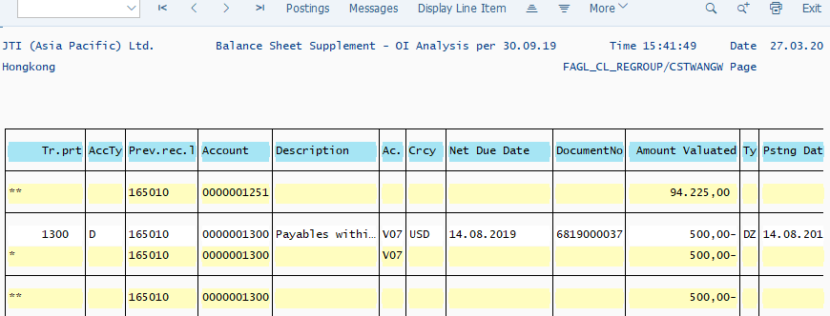
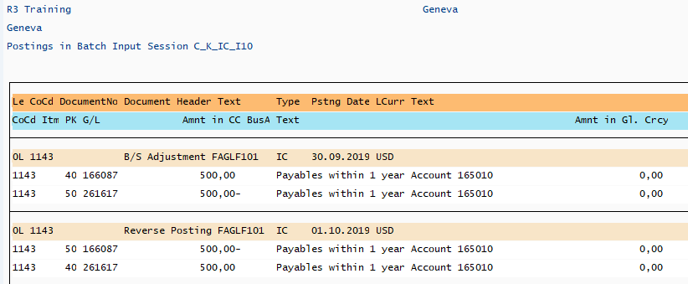
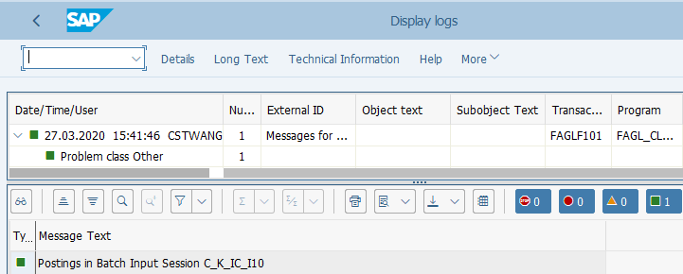
AP/AR Regrouping: Output
FAGLF101 output log
You should review and save the output log of FAGLF101 if you execute it outside of FCC.
Unlike Revaluation and Translation, you will not be able to see the actual document number of the AP/AR Regrouping posting on the Postings tab of the output log, as these documents are only proposed to be posted and will only be posted once the Batch Input session is executed in SM35.
Postings are made based on the “Sort Method” rules. In this example, a customer open item under reconciliation account 165010 has a negative balance of USD 500, which needs to be regrouped to a payable account, as you can see on the Postings log. The Line Item text describes the source reconciliation account from which the regrouping has been done.
Messages are important especially when there are errors. You should Test Run this transaction (do not select Generate Postings) to prevent critical errors during update run.
SM35

Slide 6
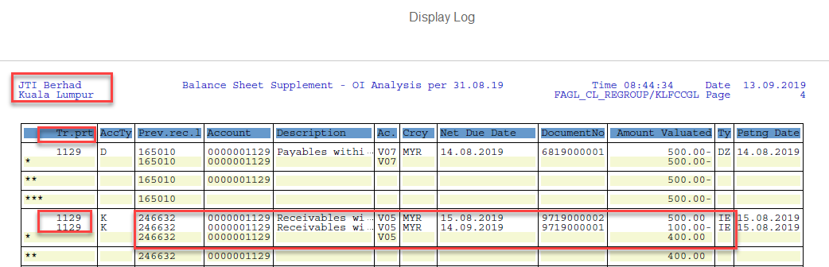
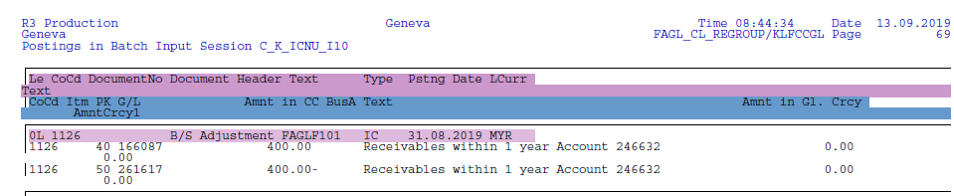
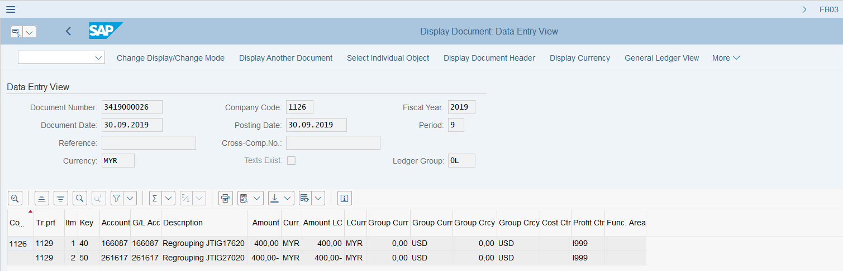
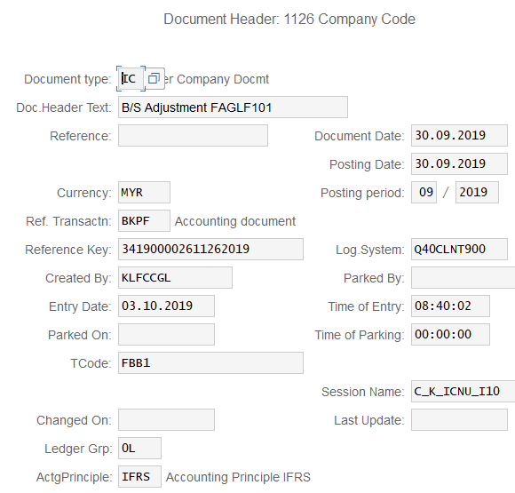
AP/AR Regrouping Posting Example
AP/AR Regrouping Log – Spool list can be displayed in FCC
AP/AR Regrouping Log – Spool list can be displayed in FCC
Accounting entries on AP/AR Regrouping documents are between the AP/AR Regrouping Adjustment accounts, which are defined per JTIG account. Values are based on the calculations that can be seen on the above logs when the transaction is executed.
Document posted based on the above log
AP/AR Regrouping is executed separately for IC AP/AR and 3rd Party AP/AR open items. Doc. Type IC and SA are used accordingly.
AP/AR Regrouping task is built in FCC, which is automatically triggered. Entities can display the job log and spool list in FCC. Note this is a GBS/JTBC level task therefore when reviewing the log you need to first locate the section for your company code on the log.
AP/AR Regrouping is executed for each accounting principle separately, therefore each posting is made to a specific ledger.

Slide 7
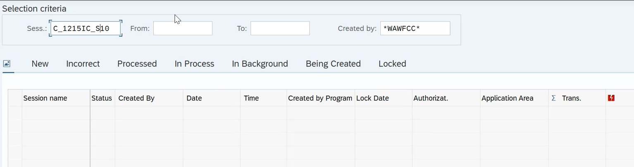
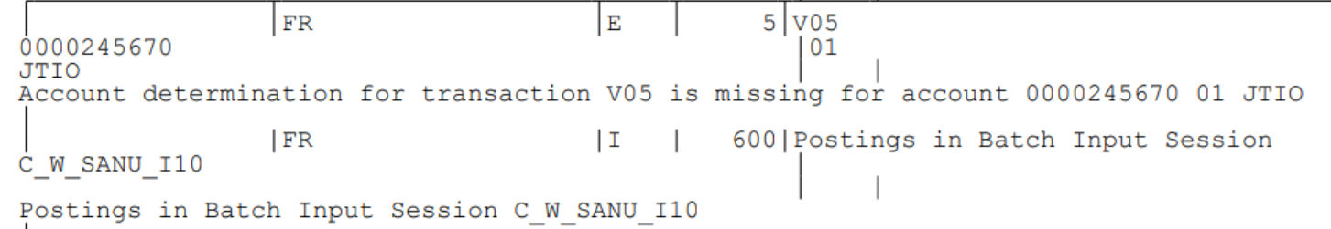
AP/AR Regrouping - Common Errors
Detail of the “Errors” can be checked from the “Output Logs”. GL Team needs to check the error and work as per the resolution mentioned below.
Errors | Error Description (Reason) | Resolution
No batch in SM35 generated | In FCLOCO the task is red for the Batch SM35 | GL Team to check spool list with list of documents to be regrouped, if no documents visible and if session name in SM35 was not generated, then it means there is nothing to post – this will not be considered as error. Change status to checked in FCC.
Account determination for transaction V05 is missing for account XXX | This error occurs when customization for Account Determination is not done. | GL Team to check in Chart of Accounts if account determination exists for XXXXXX account. If yes, inform Market that they missed account determination for their Entity and they need to raise RITM to resolve issue. Till then no need to wait, GL Team can skip this error for this month.

Slide 8
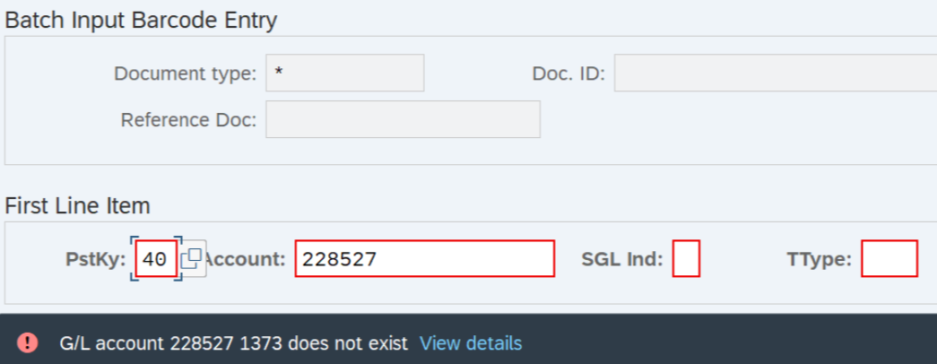
AP/AR Regrouping - Common Errors
Detail of the “Errors” can be checked from the “Output Logs”. GL Team needs to check the error and work as per the resolution mentioned below.
Errors | Error Description (Reason) | Resolution
GL Account XXX does not exist | This error occurs when GL Account for regrouping does not exist in a Company Code. | In the month when the issue is identified: - In order to process the Batch, GL Team go to T-Code SM35 and run batch manually (pass errors by clicking Enter) - GL Team to ask Market to create the account for next Period regrouping

Slide 9
Demonstration & exercises
Exercise No. 4: Perform AP/AR Regrouping using T-Code FAGLF101

